Slide 1
DBL Embedded Systems
A sorting machine to sort black and white discs
Group 16
Presenters: Phung D.T. (Dat), Keet M. (Maarten) and Petrescu T. (Tudor)

Slide 2
Subjects
Specification
Machine Design
Use-cases
User constraints
Safety properties
Machine sketch
Design decisions
Priorities
Conclusion

Slide 3
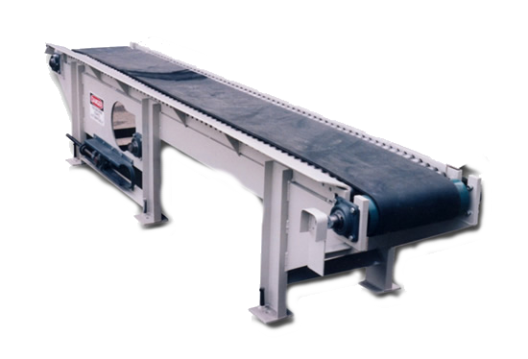
Specification
Conveyer belt requirement
Notes:
We have to make a so called sorting machine. This machine should be able to separate, by colour, small black and white plastic discs. The only real requirement in achieving this is that we need to use at least one conveyor belt. We think the conveyor belt is our biggest disadvantage. It’s rather slow compared to the detectors.

Slide 4
Machine Design
Use-cases
User constraints
Safety properties
Notes:
User constraints
Limit
Necessity: purpose, use-cases, condition
Safety properties
Example

Slide 5
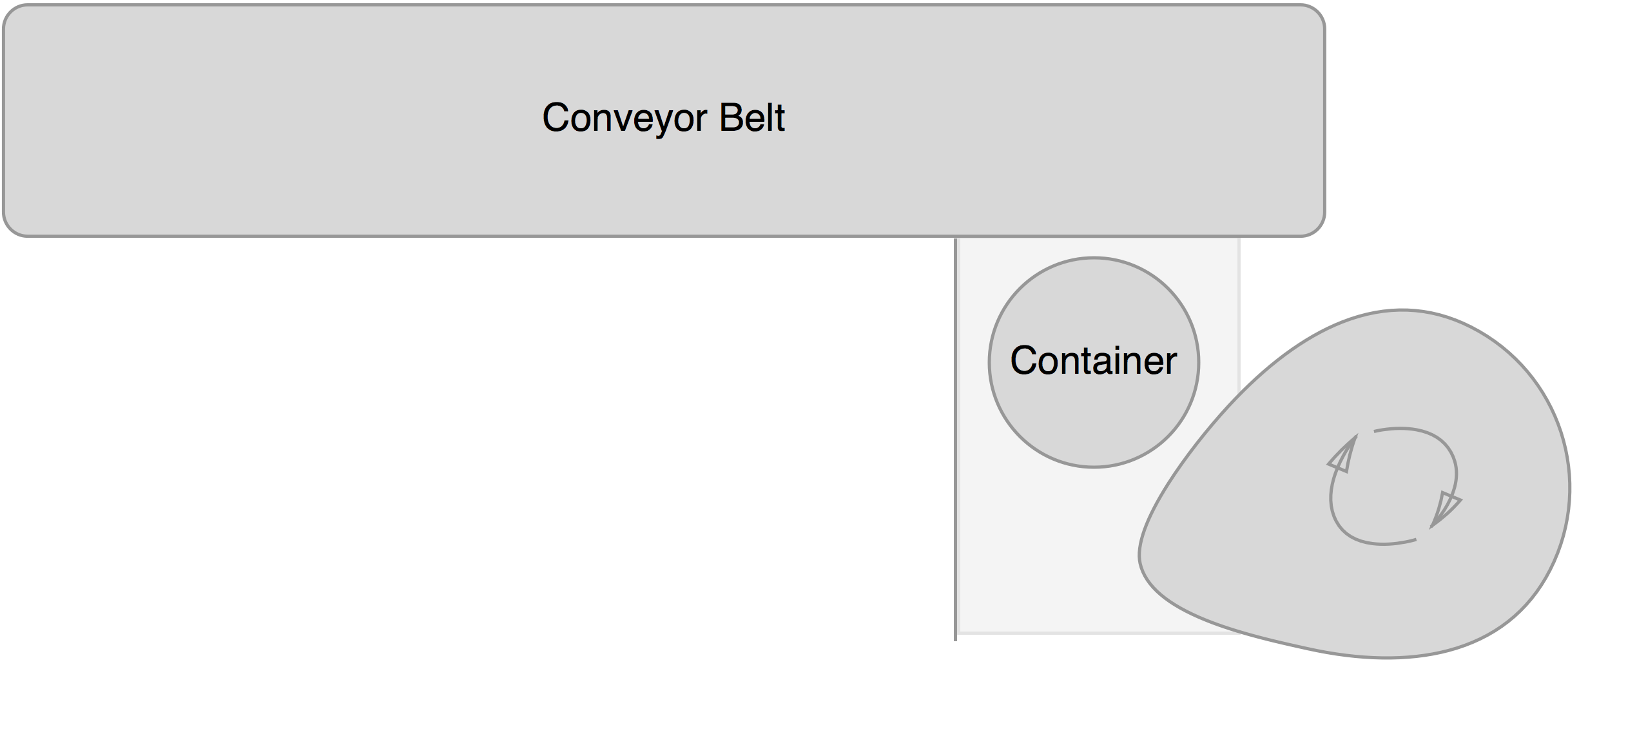
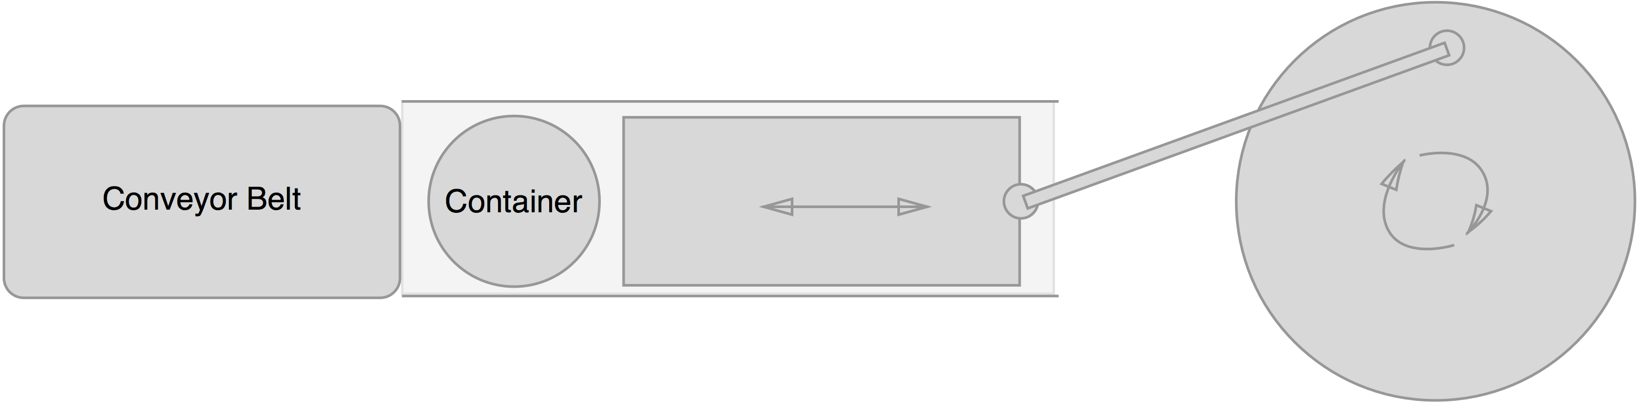
Sketches
Design 1
Design 2
Notes:
Sketch
Machine design
use-case
Both
reliable
fast
Robustness
user accessibility
first design
Wall
second design
use-case
Tudor
reliable
speed
Hinder, user accesibility
chose

Slide 6
Design Decisions
Priorities
Correctness
Speed
Robustness
Accessibility
Space used
Difficulty building
Amount of parts

Slide 7
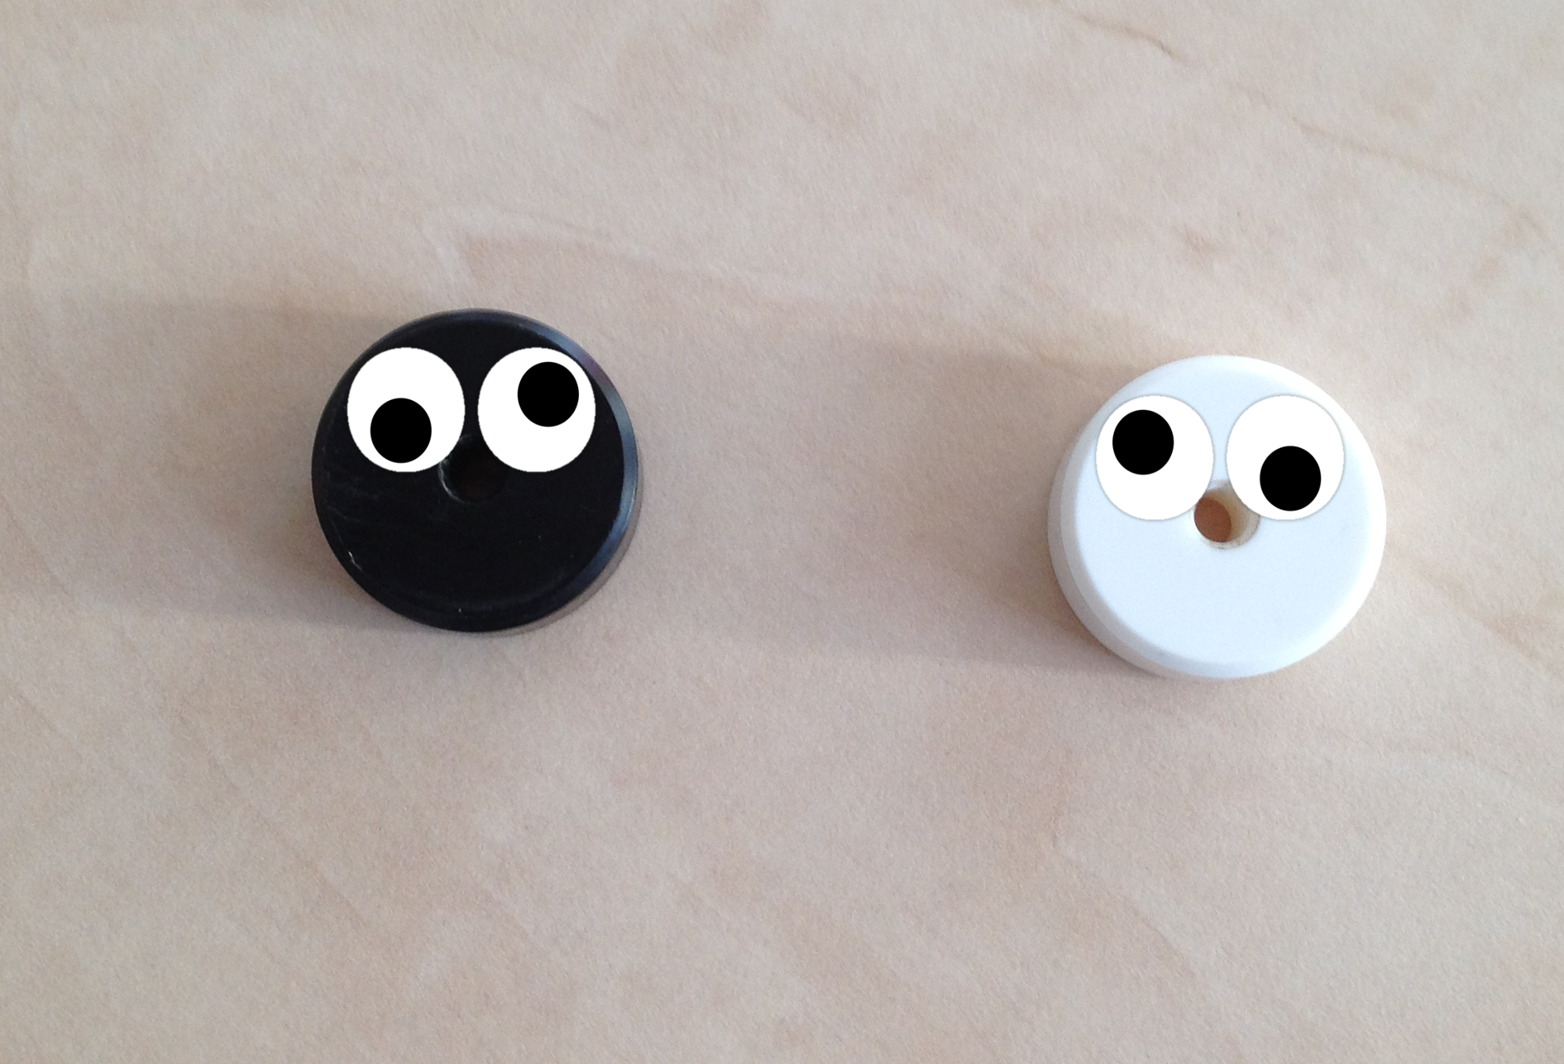
Conclusion

